Slide 1

Value-Based Care: Virtual Session Week 2

Slide 2
Agenda
Quick Background: Mapping case to Unit 4
Case Discussion

Slide 3
Review of Value Definition: (Rough) Mapping
Triple Aim | Diabetes VBC in north central London
Maximize Population Health | Clinical and social outcome measures (CSOM): Objective clinical outcomes and indicators
 | Patient reported outcome measures (PROMs): Patient reports on clinician-defined measures of well being and perceived ability to cope (EQ-5D)
Maximize Patient Experience of Care | Patient-Defined outcome measures (PDOMs): Patient’s view of care benefits
Minimize total per capita costs | (Implicit: Budget constraint)
Case illustrates that value must be clearly defined, operationalized, and accepted within the relevant care context

Slide 4
Review: Incentive Mechanisms
Unit 4 Video | Case
~Capitation | Block Payments | By geography (rather than individual or care episode). Incentives mimic capitation.
~Capitation | Capitation | By individual (can be weighted to reflect risk adjustment). May be for service subset
Bundled payments | PbR | By diagnosis / procedure (care event)
Fee for Service | FFS | By specific procedure
Shared Savings & Process Measures | Pay-for-Performance | Add-on compensation for specific, measured aspects of performance such as cost savings or measured components of care

Slide 5
Why this initiative?
Better patient experience = patient-centered, goal driven especially useful for diabetes care.
Control diabetes for better quality of life
Hard to align across different providers, link to shared outcomes and better collaboration and coordination necessary for best outcomes.
Combination
Common: diabetes care is expensive and there is a funding gap
Prevention pays off (expense & debilitation) : Health AND money
Patient compliance pays off significantly
= investment in primary care makes sense

Slide 6
Why this initiative?
Fragmented care – expensive and poorer quality
Want a better, more integrated process
Existing system didn’t have aligned incentives
Poor coordination = inadequate outcomes (want outcomes based)
Overall patient outcomes
Spending high for outcomes seen
Spending objectively high = even small percentage savings matter
Disease burden:
Clinical burden on patients who experience it
Resource consumption / outcomes
Costs increase over time
Difficulty with managing patient behaviors: patient resistance, patient barriers (context, resources/disparities, etc.)
Physician squeeze may mean fewer resources to support patients – can we fix this?

Slide 7
Why this initiative?
Incentives can create expertise
Innovation = clinical, academic, etc
USA: big employers control PCP/Primary care – key US mechanism
USA: Mergers for scale
Good clinical practice guidelines: we have clinical objectives

Slide 8
Physician perspective?
Issue: physician don’t have time for prevention!
General issues about talent management
PROS
CONS
Larger system = more flexibility to assign tasks/interventions, provider can focus on medical needs and offload
Can we afford the whole team to do what they need to do? What is the resource level?
Can I afford all of the professionals I need
Don’t lose time for provider connection…
Are we making the MD/provider’s job miserable?
Physician trust in the payment mechanisms esp regarding risk
Worried about pay, flatter for UK providers (huge for US)
Implication depends on power

Slide 9
Ensure success? (general thoughts)
Adequate stakeholders
Voices heard
Quality from different perspectives
Optimal design
Buy in first: Implementing ideas, be willing to adapt a model, explain it, create engagement. PERCEPTION of whether it will work is important; have to “sell” it.
Contracting or modeling?
Understand the problem first.
Rush to contracts:
-> Lose buy-in if you don’t have the full view. EX: Payment too low, lose trust
Data collection first: no comparison to similar health systems? How is the NHS doing now? What is the potential benefit and how do we quantify it?

Slide 10
Ensure success?
Start with modeling & measurement or start with contracting?

Slide 11
Ensure success?
Start with modeling & measurement or start with contracting?: May ITERATE!
Starting with measures and working out benchmarks, risk adjustment, ties to compensation might allow for better:
-transparency
-trust
-buy in
This will take longer to get going but might better drive more substantial behavior change IF buy in is achieved
Start with limited contracts:
Starting with with accepted measures might lead to:
lower perceived risk
lower perceived complexity
Significant change is still necessary over time but early success could create a positive feedback loop.
- Initial success stories may create motivation to accept new metrics

Slide 12
Ensure success? Most common challenges from student case write-ups
Physician Buy-In is NOT Guaranteed
Complexity up
Controllability down
Need for coordination across providers: Incentivize specialists, etc.
Need for patient adherence, etc.
Risk Adjustment
Sense of autonomy eroded by “box-ticking”
Loss aversion and other cognitive biases
Do we know enough to ask physicians to buy in?
Need integration in health record (EHR)
PDOMs new
Robust models mapping care to outcomes, by group
BUT: Lack of Resources (for data, for primary care coverage, etc.)

Slide 13
Ensure success? Analytics Ideas
Data sharing / EHR
Share best practices for integrated clinical care and associated data (e.g., clinical patient indicators such as blood levels)
Measurement of patient perspective (providers can’t align services around the patient if they don’t know what patients want)
Define outcomes and tie to incentives for transparency
Simplicity is better, but this requires precision
Consider incremental changes (e.g., low target levels that rise over time, start with a small number of process measures, start with better-understood patient populations)
Consider allowing some phased learning and buy in before providers have to absorb risk
Also, cost accounting!

Slide 14
Case Summary
Outcomes
- Overall health
- Integration
Provider Acceptance
-Complexity up
- Controllability down
Process Requirements
- Information (Analytics)
-Coordinated organizations
requires
requires

Slide 15
NHS current diabetes priorities
The importance of improving outcomes for individuals with diabetes is reflected in the inclusion in the CCG Improvement and Assessment Framework (CCG IAF) of indicators covering:
Diabetes patients that have achieved all the NICE recommended treatment targets: Three (HbA1c (blood sugar), cholesterol and blood pressure) for adults and one (HbA1c) for children
People with diabetes diagnosed less than a year who attend a structured education course.
These have been selected because they are recognized evidence-based measures of whether patients with diabetes are being supported to successfully manage their condition.
Notes:
https://www.england.nhs.uk/diabetes/treatment-care/

Slide 16
NHS Jan 2019 long-term plan
General:
Encouraging integrated care
Increasing patient control and personalization
Encouraging out-of-hospital care; coordination between GPs and community health
Diabetes Care:
Structured education and digital self-management tools for patients
Support Primary Care initiatives to achieve diabetes treatment targets
Flash glucose monitors
Notes:
https://www.longtermplan.nhs.uk/

Slide 17
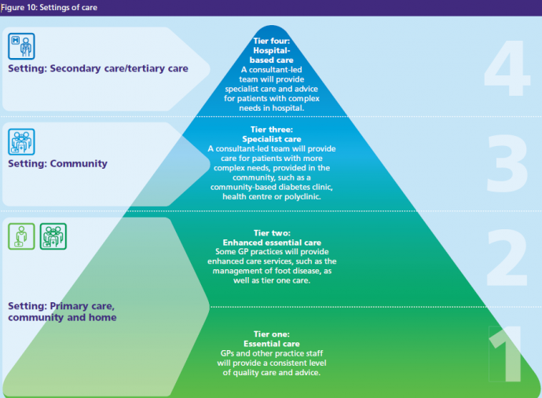
Notes:
https://www.royalfree.nhs.uk/services/services-a-z/diabetes-camden-ipu/our-model-of-care/

Slide 18

Notes:
https://www.gov.uk/government/publications/health-matters-preventing-type-2-diabetes/health-matters-preventing-type-2-diabetes

Slide 19
Case Lessons
Aligning incentives in value-based care
Definition of desired objectives / outcomes is crucial, and difficult
Health outcomes are multi-determined, so incentivizing health outcomes often increases complexity
Implementing incentive alignment around health outcomes:
Integration often lowers controllability (so does patient co-production)
Information: Policymakers, payers, and/or providers must invest in mapping from care processes to health outcomes.
Importance of your skills!
Transition to Section 2

Slide 20
 | Video Units | Weekly Activities
 | U1: Introduction | Course Week 1
 | U2: Decision Making
Section 1: Incentives | U3: Conflicts of Interest
 | U4: Value Based Incentives | Course Week 2 -Video Unit 4 -NHS case: Example operationalization
 | U5: Unintended Consequences | Course Week 3
Section 2: Information | U6: Variation in Spending
 | U7: ICER and QALY | Course Week 4
 | U8: Risk Adjustment
Section 3: Influence | U9: Patient Decision Making | Course Week 5
 | U10: Patient Adherence
 | U11: Patient Consumers
 | U12: Wrap | Course Week 6

Slide 21
 | Video Units | Weekly Activities
 | U1: Introduction | Course Week 1
 | U2: Decision Making
Section 1: Incentives | U3: Conflicts of Interest
 | U4: Value Based Incentives | Course Week 2
 | U5: Unintended Consequences | Course Week 3 Guest Speakers Team Assignment
Section 2: Information | U6: Variation in Spending
 | U7: ICER and QALY | Course Week 4
 | U8: Risk Adjustment
Section 3: Influence | U9: Patient Decision Making | Course Week 5
 | U10: Patient Adherence
 | U11: Patient Consumers
 | U12: Wrap | Course Week 6

Slide 22
DUMC Speakers
Wendy Webster, MA, MBA
Director of Clinical Operations
Duke Surgery
Duke Neurosurgery
Michael Lipkin, MD, MBA
Associate Professor Urologic Surgery
Associate Chief Medical Officer, Clinical Operations, Duke Private Diagnostic Clinics
Chief of the Clinics, Department of Surgery

Slide 23
Thanks! Questions?

